Slide 1
The Canvas
Creating Graphics for the Web
Telerik Software Academy
Learning & Development Team
http://academy.telerik.com

Slide 2
Table of Contents
Overview and usage of the canvas
Drawing shapes
Rectangles, arcs and ellipses
Lines, paths and Bézier curves
Drawing Text
Per-pixel manipulations

Slide 3
Table of Contents (2)
Canvas styles
fillColor and strokeColor
Gradients, patterns and shadows
Transformations
Save and restore context state
Translate

Slide 4
The Canvas

Slide 5
The Canvas
The Canvas is the way to draw in the browser
Uses JavaScript for the drawing
Enables high-performance drawing
The Canvas is part of the HTML5 specification
Supported in most browsers
Both desktop and mobile

Slide 6
Using the Canvas
The Canvas is a rectangular sheet
All the drawing is done inside this sheet
The canvas consists of:
<canvas> HTML element
JavaScript API for the drawing
Set width and height
<canvas id="the-canvas" width="100" height="100" />
var canvas = document.getElementById('the-canvas');
var canvasCtx = canvas.getContext('2d');
canvasCtx.fillRect(10, 10, 30, 30);

Slide 7
The Canvas Context
The canvas HTML element provides many ways for drawing
Rectangular 2d drawing
3d drawing
WebGL drawing
HTML5 provides APIs for all these types of drawing
The way to use a specific canvas API is to get the corresponding context

Slide 8
Using the Canvas
Live Demo

Slide 9
Drawing Shapes

Slide 10
Canvas Shapes
The Canvas provides ways to draw all kinds of shapes
Rects, arcs, ellipses, lines, etc…
Each of these shapes can be either
Drawn in full color (i.e. filled)
Drawn only their border (i.e. stroked)
var canvas = document.getElementById('the-canvas');
var canvasCtx = canvas.getContext('2d');
canvasCtx.fillRect(10, 10, 25, 25);
canvasCtx.strokeRect(10, 10, 25, 25);

Slide 11
Drawing Rects
Drawing rects is the simplest way to draw with the canvas
Build-in functionality
context.fillRect (x, y, width, height)
Creates a rectangular shape at position (x, y) from the top left corner of the canvas
The shape is drawn in full color
context.strokeRect (x, y, width, height)
Same as fillRect
Only the border of the shape is drawn

Slide 12
Drawing Rects: Example
Drawing a rectangle filled with light blue and with dark blue border
<canvas id="rects-canvas"> </canvas>
var canvas = document.getElementById('rects-canvas'),
ctx = canvas.getContext('2d');
ctx.fillStyle = 'rgb(107, 187, 201)';
ctx.strokeStyle = 'rgb(2, 55, 155)';
ctx.fillRect(20, 20, 140, 90);
ctx.strokeRect(20, 20, 140, 90);

Slide 13
Drawing Rectangles
Live Demo

Slide 14
Canvas Paths

Slide 15
Canvas Paths
The Canvas can do much more than just drawing rectangles
Bezier curves, ellipses, arcs
Much of the power of the Canvas comes from the path
The path is just a set of connected dots
Depending on the method used, the dots can be connected using straight line or curve

Slide 16
Canvas Path (2)
The canvas context has methods for paths:
beginPath()
Starts path
moveTo(x, y)
Changes the position of the path marker
lineTo(x, y)
Draws a straight line from the position of the path marker to position (x, y)
fill() / stroke()
Fills or strokes the path

Slide 17
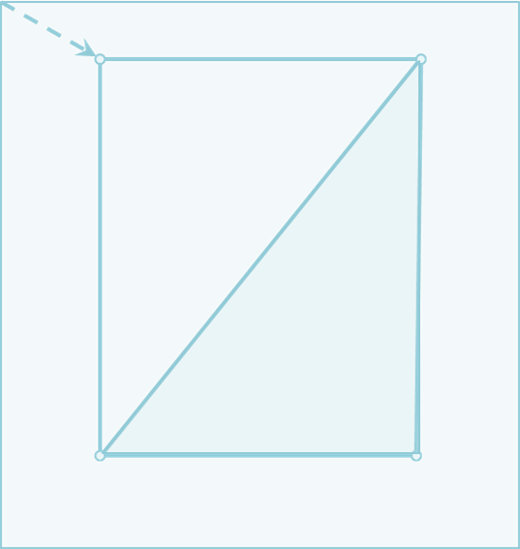
How the Canvas Works?
The canvas only marks dots on the canvas sheet
And remembers how these dots are connected
When fill() or stroke() is reached, all dots are connected at once
ctx.beginPath();
ctx.moveTo(50, 50);
ctx.lineTo(50, 300);
ctx.lineTo(200, 50);
ctx.lineTo(50, 50);
ctx.stroke();
ctx.beginPath();
ctx.moveTo(200, 50);
ctx.lineTo(200,300);
ctx.lineTo(50, 300);
ctx.closePath();
ctx.fill();

Slide 18
How the Canvas Works?
canvas.beginPath() tells the Canvas that a new path is started
ctx.beginPath();
ctx.moveTo(50, 50);
ctx.lineTo(50, 300);
ctx.lineTo(200, 50);
ctx.lineTo(50, 50);
ctx.stroke();
ctx.beginPath();
ctx.moveTo(200, 50);
ctx.lineTo(200,300);
ctx.lineTo(50, 300);
ctx.closePath();
ctx.fill();

Slide 19
How the Canvas Works?
moveTo(50, 50) moves the canvas marker to position (50, 50), relatively to the top left corner
ctx.beginPath();
ctx.moveTo(50, 50);
ctx.lineTo(50, 300);
ctx.lineTo(200, 50);
ctx.lineTo(50, 50);
ctx.stroke();
ctx.beginPath();
ctx.moveTo(200, 50);
ctx.lineTo(200,300);
ctx.lineTo(50, 300);
ctx.closePath();
ctx.fill();

Slide 20
How the Canvas Works?
lineTo(50, 300) marks a straight line between dots with coordinates (50, 50) and (50, 300)
ctx.beginPath();
ctx.moveTo(50, 50);
ctx.lineTo(50, 300);
ctx.lineTo(200, 50);
ctx.lineTo(50, 50);
ctx.stroke();
ctx.beginPath();
ctx.moveTo(200, 50);
ctx.lineTo(200,300);
ctx.lineTo(50, 300);
ctx.closePath();
ctx.fill();

Slide 21
How the Canvas Works?
lineTo(200, 50) marks a straight line between dots with coordinates (50, 300) and (200, 50)
ctx.beginPath();
ctx.moveTo(50, 50);
ctx.lineTo(50, 300);
ctx.lineTo(200, 50);
ctx.lineTo(50, 50);
ctx.stroke();
ctx.beginPath();
ctx.moveTo(200, 50);
ctx.lineTo(200,300);
ctx.lineTo(50, 300);
ctx.closePath();
ctx.fill();

Slide 22
How the Canvas Works?
lineTo(50, 50) marks a straight line between dots with coordinates (200, 50) and (50, 50)
ctx.beginPath();
ctx.moveTo(50, 50);
ctx.lineTo(50, 300);
ctx.lineTo(200, 50);
ctx.lineTo(50, 50);
ctx.stroke();
ctx.beginPath();
ctx.moveTo(200, 50);
ctx.lineTo(200,300);
ctx.lineTo(50, 300);
ctx.closePath();
ctx.fill();

Slide 23
How the Canvas Works?
stroke() strokes the lastly created path with the given strokeColor (default is black, #000000)
ctx.beginPath();
ctx.moveTo(50, 50);
ctx.lineTo(50, 300);
ctx.lineTo(200, 50);
ctx.lineTo(50, 50);
ctx.stroke();
ctx.beginPath();
ctx.moveTo(200, 50);
ctx.lineTo(200,300);
ctx.lineTo(50, 300);
ctx.closePath();
ctx.fill();

Slide 24
How the Canvas Works?
canvas.beginPath() tells the Canvas that a new path is started
ctx.beginPath();
ctx.moveTo(50, 50);
ctx.lineTo(50, 300);
ctx.lineTo(200, 50);
ctx.lineTo(50, 50);
ctx.stroke();
ctx.beginPath();
ctx.moveTo(200, 50);
ctx.lineTo(200,300);
ctx.lineTo(50, 300);
ctx.closePath();
ctx.fill();

Slide 25
How the Canvas Works?
moveTo(200, 50) moves the canvas marker to position (200, 50), relatively to the top left corner
ctx.beginPath();
ctx.moveTo(50, 50);
ctx.lineTo(50, 300);
ctx.lineTo(200, 50);
ctx.lineTo(50, 50);
ctx.stroke();
ctx.beginPath();
ctx.moveTo(200, 50);
ctx.lineTo(200,300);
ctx.lineTo(50, 300);
ctx.closePath();
ctx.fill();

Slide 26
How the Canvas Works?
lineTo(200, 300) marks a straight line between dots with coordinates (200, 50) and (200, 300)
ctx.beginPath();
ctx.moveTo(50, 50);
ctx.lineTo(50, 300);
ctx.lineTo(200, 50);
ctx.lineTo(50, 50);
ctx.stroke();
ctx.beginPath();
ctx.moveTo(200, 50);
ctx.lineTo(200,300);
ctx.lineTo(50, 300);
ctx.closePath();
ctx.fill();

Slide 27
How the Canvas Works?
lineTo(50, 300) marks a straight line between dots with coordinates (200, 300) and (50, 300)
ctx.beginPath();
ctx.moveTo(50, 50);
ctx.lineTo(50, 300);
ctx.lineTo(200, 50);
ctx.lineTo(50, 50);
ctx.stroke();
ctx.beginPath();
ctx.moveTo(200, 50);
ctx.lineTo(200,300);
ctx.lineTo(50, 300);
ctx.closePath();
ctx.fill();

Slide 28
How the Canvas Works?
closePath() connects the first and the last dots from the path
ctx.beginPath();
ctx.moveTo(50, 50);
ctx.lineTo(50, 300);
ctx.lineTo(200, 50);
ctx.lineTo(50, 50);
ctx.stroke();
ctx.beginPath();
ctx.moveTo(200, 50);
ctx.lineTo(200,300);
ctx.lineTo(50, 300);
ctx.closePath();
ctx.fill();

Slide 29
How the Canvas Works?
fill() fills the lastly created path with the given fillColor (by default black, #000000)
ctx.beginPath();
ctx.moveTo(50, 50);
ctx.lineTo(50, 300);
ctx.lineTo(200, 50);
ctx.lineTo(50, 50);
ctx.stroke();
ctx.beginPath();
ctx.moveTo(200, 50);
ctx.lineTo(200,300);
ctx.lineTo(50, 300);
ctx.closePath();
ctx.fill();

Slide 30
Using the Path
Live Demo

Slide 31
Drawing Ellipses

Slide 32
Drawing Ellipses
The Canvas has a built-in methods for drawing ellipses
arc(x, y, radius, from, to, counterclockwise)
Draws a circle with center at (x, y) from position "from" to position "to"
Positions in ellipses are described using radians (degrees)
The formula is:
radians = degrees * PI/180
0 degrees == 0.0*PI radians
90 degress == 0.5*PI radians
180 degrees == 1.0*PI radians
270 degrees == 1.5*PI radians
360 degrees == 2.0*PI radians

Slide 33
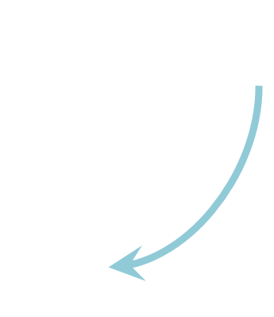
Drawing Ellipses (2)
270 degrees
1.5*PI radians
180 degrees
0 (360) degrees
PI radians
0 (2*PI) radians
90 degrees
0.5*PI radians

Slide 34
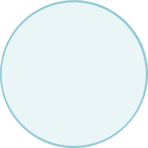
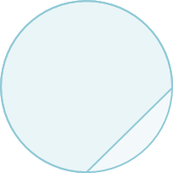
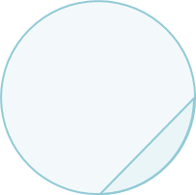
Drawing Ellipses: Example
To draw ellipses, a Path must be started:
ctx.beginPath();
Draw a full circle
//clockwise
ctx.arc(x, y, r, 0, 2*Math.PI);
//counter clockwise
ctx.arc(x, y, r, 2*Math.PI, 0, true);
Draw a segment of an ellipse
//The smaller part (clockwise)
ctx.arc(x, y, r, Math.PI/2, 2*Math.PI);
//the bigger part (counterclockwise)
ctx.arc(x, y, r, Math.PI/2, 2*Math.PI, true);

Slide 35
Drawing Ellipses and Segments
Live Demo

Slide 36
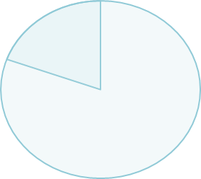
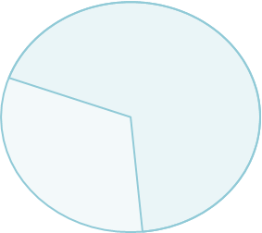
Drawing Circular Sectors
A circular sector is the portion of a circle enclosed by two radiuses
The Canvas has no built-in methods for creating circular sectors
Yet, the Canvas supports paths
A circle sector can be done by creating a sector and then a line to the center of the circle

Slide 37
Drawing Circular Sectors: Example
context.closePath() connects the first and the last dots from the Path
function drawSector(x, y, r, from, to, isCounterClockwise) {
ctx.beginPath();
ctx.arc(x, y, r, from, to, isCounterClockwise);
ctx.lineTo(x, y);
ctx.closePath();
ctx.stroke();
}

Slide 38
Drawing Circular Sectors
Live Demo

Slide 39
Drawing Curves

Slide 40
Drawing Curves with The Canvas
The Canvas supports two types of curves:
Quadratic curves
A simple curve drawn based on a control point
Bezier curves
A more complex curve based on two control points
Both quadratic and Bezier curves are done using a path

Slide 41
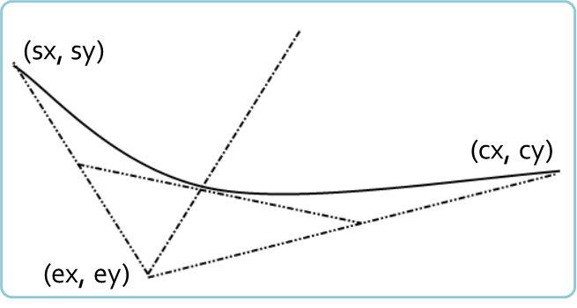
Quadratic Curves
Quadratic curves are basic curves
Using two context points and a control point
The first is the last point from the path (sx, sy)
The second is the one from the curve (cx, cy)
context.quadraticCurveTo(cx, cy, ex, ey)

Slide 42
Quadratic Curves
Live Demo

Slide 43
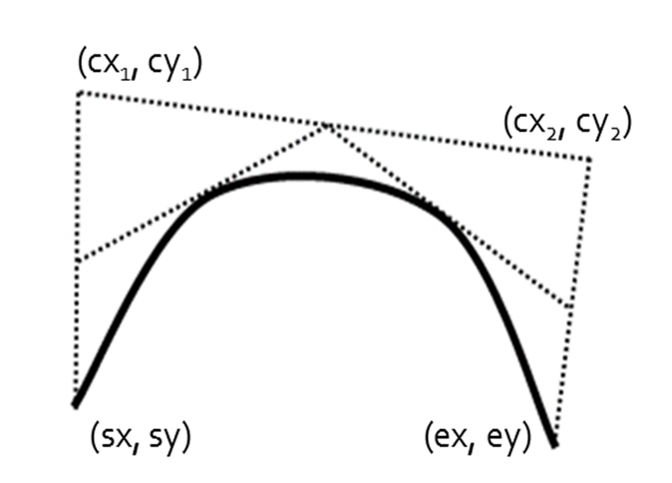
Bezier Curves
Bezier curves are like quadratic curves, but with two context and two control points
context.bezierCurveTo(cx₁, cy₁, cx₂, cy_{2,} ex, ey, )

Slide 44
Bezier Curves
Live Demo

Slide 45
Drawing Text in Canvas

Slide 46
Drawing Text
The HTML5 canvas can also draw text:
Methods:
context.fillText (text, x, y) – fills the given text
context.strokeText (text, x, y) – draws only the border of the text
Properties:
context.font – sets the font size and font family of the text
context.fillStyle – the fill color of the text
context.strokeStyle – the stroke color of the text

Slide 47
Drawing Text: Example
Draw the text 'Telerik Academy'
Filled with yellowgreen color, stroked with dark green color
Font family – Arial
Font sizes – from 28px to 48px
minFontSize = '28';
currentFontSize = 48;
while (minFontSize <= currentFontSize) {
ctx.font = currentFontSize + 'px ' + 'Arial';
ctx.fillText(text, x, y);
ctx.strokeText(text, x, y);
y += currentFontSize + offset;
currentFontSize -= 4;
}

Slide 48
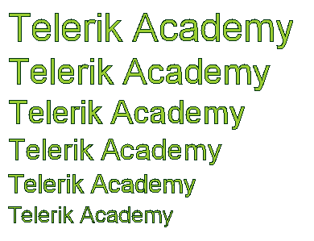
Drawing Text: Example
Draw the text 'Telerik Academy'
Filled with yellowgreen color, stroked with dark green color
Font family – Arial
Font sizes – from 28px to 48px
minFontSize = '28';
currentFontSize = 48;
while (minFontSize <= currentFontSize) {
ctx.font = currentFontSize + 'px ' + 'Arial';
ctx.fillText(text, x, y);
ctx.strokeText(text, x, y);
y += currentFontSize + offset;
currentFontSize -= 4;
}

Slide 49
Drawing Text in Canvas
Live Demo

Slide 50
Canvas Styles

Slide 51
Canvas Styles
The canvas supports two styles
Styles for fill and stroke
Can be either a solid color or pattern
Styles for types of stroke
Dashed or solid
Done using kind of workaround

Slide 52
Canvas Styles
Live Demo

Slide 53
Transformations

Slide 54
Canvas Transformations
The Canvas can do transformations
i.e. it can be rotated, scaled or transformed
context.scale(d_{x}, d_{y}) – all coordinates and points are scaled
fillRect(X, X, W, H) will draw a rectangle
At position (d_{x} * X, d_{y} * Y)
With width (d_{x}* W) and height (d_{y}* H)
context.rotate(D) – all drawing is rotated with angle D degrees

Slide 55
Transformations
Live Demo

Slide 56
Canvas Per-pixel Manipulation

Slide 57
Canvas Per-pixel Manipulation
Canvas supports per-pixel manipulation
All the pixels can be manipulated one-by-one
Use the context.getImageData(x, y, w, h)
Returns the image data object
The image data is for the rectangle with top-left corner at (x, y) with width w and height h
The image data contains an array of numbers for each of the pixels

Slide 58
Canvas Per-pixel Manipulation (2)
The array of pixels holds values between 0 and 255
Each value represents a color component from RGBA
The pixels are grouped in triples in the array
The color values for the i-th pixel are at positions:
pixels[i] holds the RED component
pixels[i+1] holds the GREEN component
pixels[i+2] holds the BLUE component

Slide 59
Canvas Per-pixel Manipulation: Example
Invert all the colors of an canvas
var imageData =
ctx.getImageData(150, 150, ctx.canvas.width, ctx.canvas.height);
for(var i = 0 ; i < imageData.data.length; i+=4){
imageData.data[i] = 255 - imageData.data[i];
imageData.data[i+1] = 255 - imageData.data[i+1];
imageData.data[i+2] = 255 - imageData.data[i+2];
}
ctx.putImageData(imageData, 0, 0);

Slide 60
Canvas Per-pixel Manipulation
Live Demo

Slide 61
The Canvas
http://academy.telerik.com

Slide 62
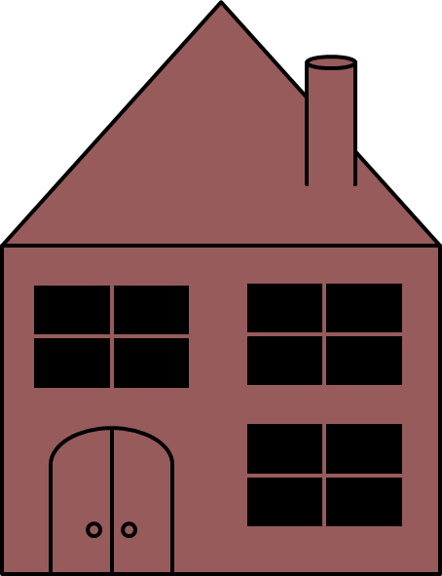

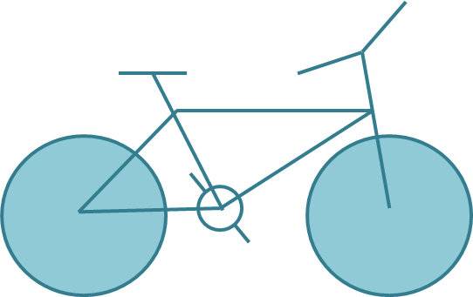
Homework
Draw the following graphics using canvas:

Slide 63
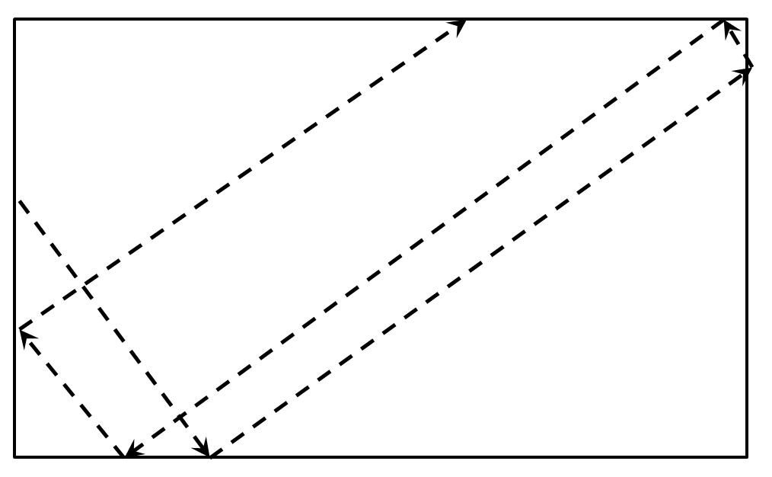
Homework (5)
Draw a circle that flies inside a box
When it reaches an edge, it should bounce that edge

Slide 64
Homework (7)
*Create the famous game "Snake"
The snake is a sequence of rectangles/ellipses
The snake can move left, right, up or down
The snake dies if it reaches any of the edges or when it tries to eat itself
A food should be generated
When the snake eats the food, it grows and new food is generated at random position
Implement a high-score board, kept in localStorage

